Slide 1
Azure Overview
Michael S. Collier
Cloud Solution Architect, Microsoft

Slide 2
Michael S. Collier
Cloud Solution Architect, Microsoft
michael.collier@microsoft.com
michaelscollier@gmail.com
@MichaelCollier
www.MichaelSCollier.com
http://aka.ms/csablog

Slide 3
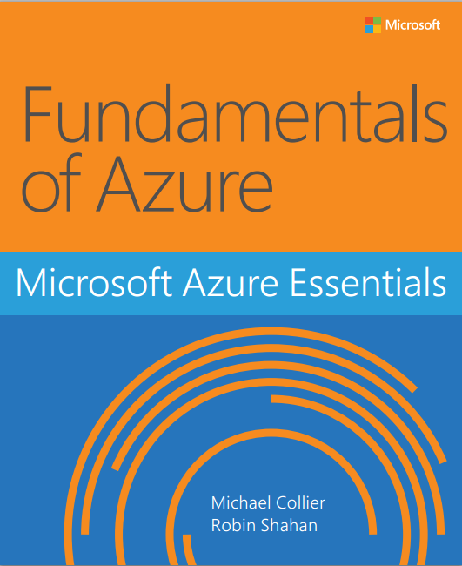
http://aka.ms/fundamentalsofazure

Slide 4
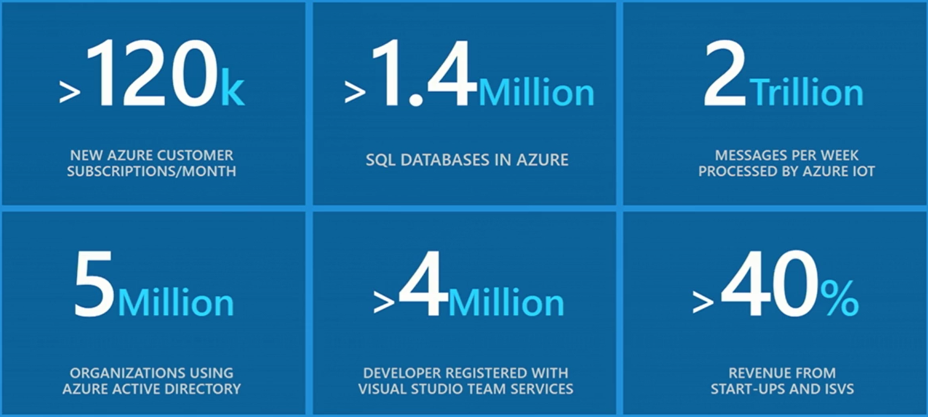
Azure Momentum
//BUILD 2016 – Day 2 Keynote
Notes:
https://channel9.msdn.com/Events/Build/2016/KEY02#time=5m25s

Slide 5

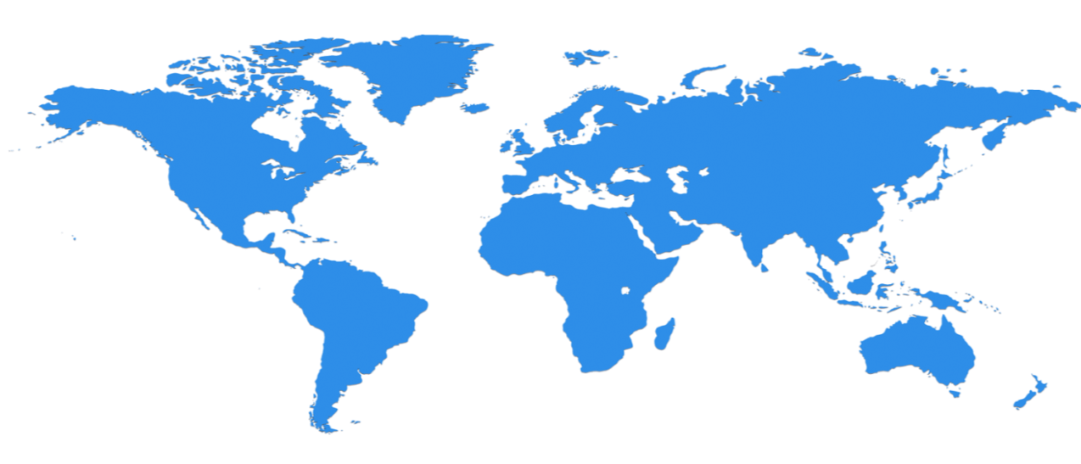

Regional management, regional resilience
North Central US
Illinois
North Europe
Ireland
West Europe
Netherlands
Central US
Iowa
Canada Central
Toronto
Canada East
Quebec City
US Gov
Iowa
China North *
Beijing
China South *
Shanghai
Japan East
Saitama
West US
California
East US
Virginia
India Central
Pune
Japan West
Osaka
South Central US
Texas
East US 2
Virginia
US Gov
Virginia
India South
Chennai
India West
Mumbai
East Asia
Hong Kong
SE Asia
Singapore
Australia East
New South Wales
30 Azure Regions
22 Generally Available
8 Announced
More than AWS and Google Cloud combined!
Brazil South
Sao Paulo
Australia South East
Victoria
Operational
Announced/Not Operational
* Operated by 21Vianet
Notes:
Map does not include all Azure regions (Germany, United Kingdom, etc.)
https://azure.microsoft.com/en-us/regions/#overview

Slide 6
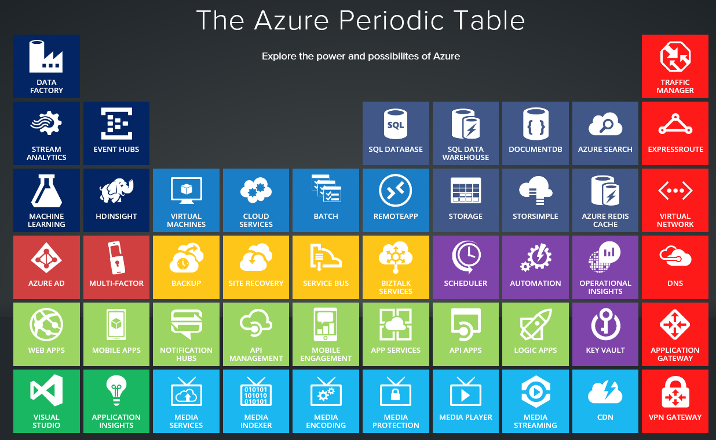
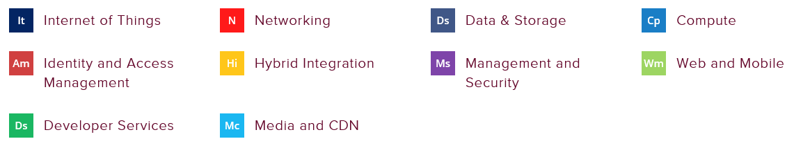
http://www.concurrency.com/landing/azure-periodic-table
Notes:
Stream Analytics vs. Apache Spark
Event Hubs vs. Kafka
Automation -> System Center Orchestration Manager & DSC
Transition – Talk about two of the most popular & common services (starting points for many people) – Azure App Service and Azure VMs

Slide 7
Azure App Service

Slide 8
Azure App Service
Azure App Service provides an integrated cloud app platform for delivering modern enterprise apps across cloud and mobile devices. Azure App Service is an integrated offering that delivers features and capabilities from a number of existing Azure services – Websites, Mobile Services, API Mgmt. and BizTalk Services
Enterprise Grade Apps
Fully Managed Platform
High Productivity Development

Slide 9





Azure App Service
Web Apps
Mobile Apps
Logic Apps
Functions
Web apps that scale with your business
Build Mobile apps for any device
Automate business process across SaaS and on-premises
Listen and react to events across your stack
API Apps
Easily build and consume APIs in the cloud

Slide 10
Benefits of App Services
Automatic OS patching
Enterprise-grade security
High availability
Automated scale out/in
Built-in load balancing
Supports many languages and platforms
.NET, Node.js, Python, Ruby and many more
Easy continuous deployment
Continuous delivery from third-party source control providers
Built-in Git repo

Slide 11
App Service Web App Architecture
Deployment
Server(s)
File Server
Publish Endpoint
Blob Storage
Application Database
Frontend (IIS ARR)
Azure
Load Balancer
Metering
Runtime Database
API Endpoint

Slide 12
Azure App Service
Demo
Notes:
Show creating an App Service in portal
Create a basic ASP.NET site and deploy via VStudio
Back to PPTX – Talk about HA
Show HA demo – Two web apps, SQL DB, TM, and GitHub

Slide 13



High Availability
East US
1
Priority
West US
2

Slide 14
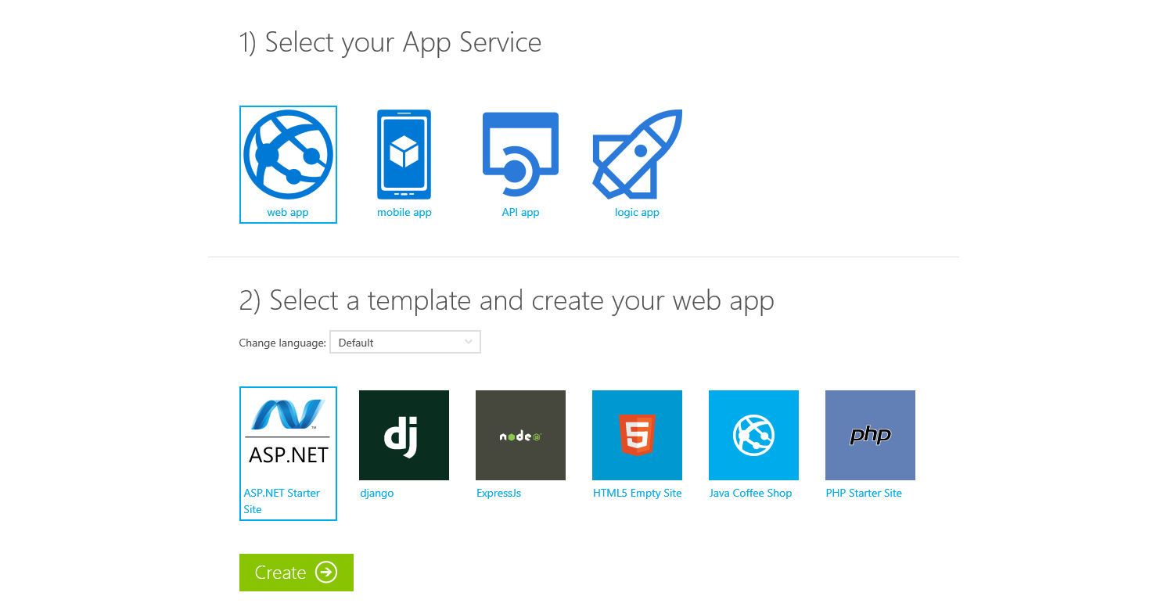
Try App Service Today
Free
No Signup or Account Required
https://tryappservice.azure.com

Slide 15
Azure Virtual Machines

Slide 16

Windows and Linux virtual machines
Deploy your server workload in minutes
Secure, compliant solutions
Azure Disk Encryption
Hybrid Connections
Premium Storage
Up to 80,000 IOPs

Slide 17







Linux and Open Technologies
Endorsed Distributions
Community and DIY Images
Docker Integration
Favorite Languages
DevOps Ready
Enterprise Workloads
Full Java Support

Slide 18
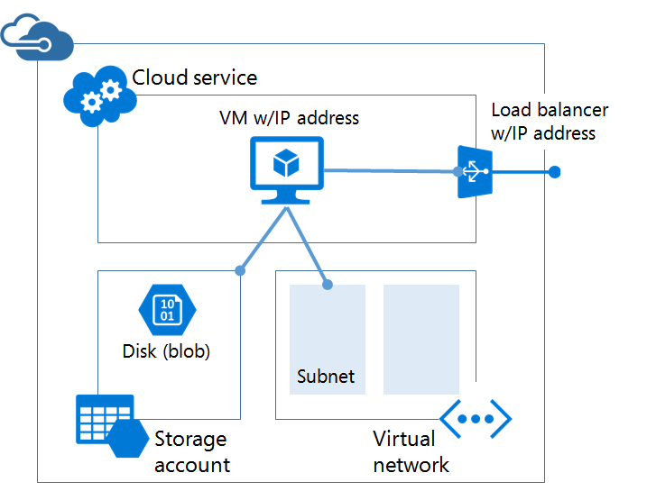
Resource Manager (ARM) vs. Classic (ASM)
Leverages the PaaS Cloud Service model
Implicit Cloud Service (e.g. contoso.cloudapp.net)
Load balancer, public IP, DIP are automatically enabled
Limited network control
2 Fault Domains

Slide 19
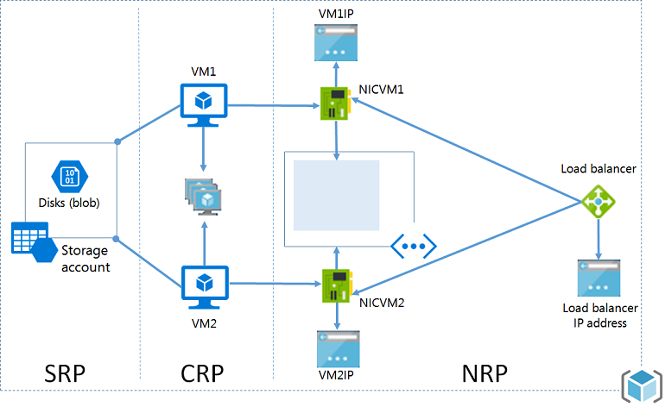
Resource Manager (ARM) vs. Classic (ASM)
Explicit, fine-grained control
IP, NIC, storage accounts, LB, DNS, VNET, etc.
3 Fault Domains
Shareable Template File
Tags
RBAC
Future innovations here

Slide 20
Azure Virtual Machines
Demo
Notes:
Deploy a basic Windows VM from gallery
Show pre-built Windows and Linux VM
Export template for pre-built VMs
Deploy ARM template from gallery - https://github.com/Azure/azure-quickstart-templates/tree/master/201-2-vms-loadbalancer-lbrules

Slide 21
Lessons Learned
The good and the bad

Slide 22

Disruptive Force . . . For Good
“The Cloud” changes everything
Development and release management processes
DevOps is the norm
Cost model
who pays for it?
overprovisioning?
Code / application efficiency
Democratization of IT
Anybody with a credit card can do it!
IT will either embrace “the cloud”
or get bypassed
Image Credit: http://mrg.bz/dcnEGJ

Slide 23
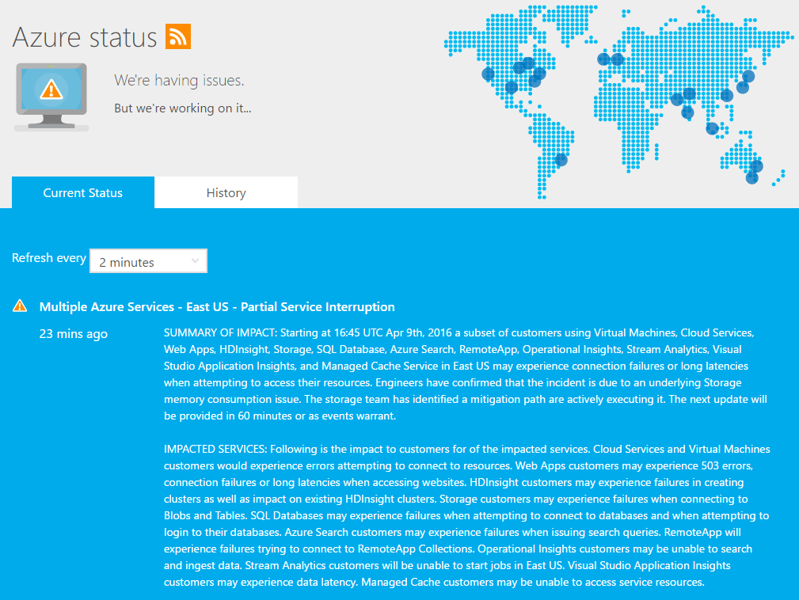
It WILL Fail
SLAs – insurance policy
More you use – greater the risk
Be prepared!
What’s the customer’s experience?

Slide 24
Rethink Software Lifecycle
Always available is the expectation
Continuous deployment is the norm
How do you handle app upgrades?
App Services - staging slots
Traffic Manager
API Management
Rolling upgrades (Cloud Services & Service Fabric)

Slide 25
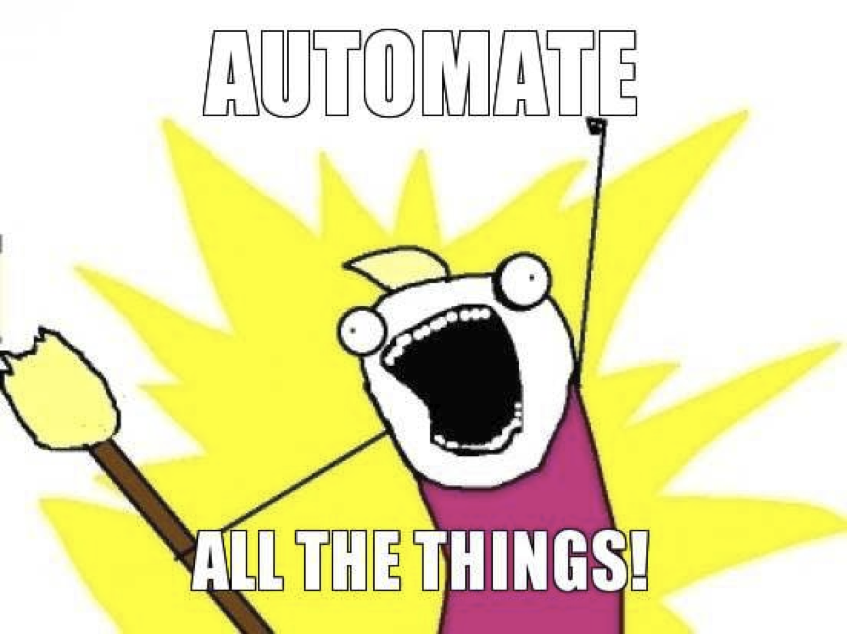
Automation, Automation, Automation
Humans terrible at repetitive tasks
Deploy to multiple geographies
Change only configuration
Options
REST API (ASM or ARM)
Azure Management Library
PowerShell
Azure CLI
Azure Automation
Image Credit: https://www.chef.io/blog/wp-content/uploads/2012/02/automate-all-the-things.png

Slide 26

Instrumentation & Telemetry – MUST HAVE
How do you “see” at scale?
Platform services – there is no box to RDP into!
Diagnose failures
Your fault?
Azure’s fault?
Distributed services with own SLAs
Many, many options – Just Do It!
https://www.chriswatterston.com/blog/my-there-no-cloud-sticker

Slide 27
//BUILD 2016
Azure Announcements

Slide 28
Internet of Things
IoT Starter Kits
5 Azure Certified for IoT kits
$50 - $160 per kit
IoT Hub Device Management
Enroll, view status & health, organize, control access and update software/firmware
IoT Gateway SDK (preview)
Source code for development of gateway application

Slide 29
Microservices
Azure Service Fabric
Powers Azure SQL Database, DocumentDB, Intune, Cortana, Skype for Business, and more
Lifecycle mgmt., stateless & stateful services, high availability
Reliable Services and Reliable Actors
Preview for Windows Server – your datacenter or other clouds
Linux support coming soon
Azure Functions
Serverless, on-demand compute for event-driven applications
Code triggered by an event
PHP, C#, Java, Node.js, Python
App Service Plan or Dynamic Service Plan

Slide 30
Data and Intelligence
Cortana Intelligence Suite
Bot Framework
Cognitive Services
Power BI Embedded
Build interactive reports and visualizations into apps (native experience)
Leverage Power BI visuals

Slide 31
Azure SDK 2.9
Visual Studio “15” preview
Performance Diagnostics with Service Profiler (preview)
Diagnostic Improvements for visualizing data with Application Maps
Event Hub for Azure Diagnostics
KeyVault support for ARM templates
Secondary App Service Creation
Tools for Docker preview
Microsoft Service Fabric Tools for Visual Studio
Azure Data Lake Tools for Visual Studio
Azure Resource Manager Tools for Visual Studio Code
More Info: https://azure.microsoft.com/en-us/blog/announcing-visual-studio-azure-tools-and-sdk-2-9/

Slide 32
Virtual Machines
Larger VM Size – Dedicated Hardware
Standard_D15_v2
20 CPU cores
140 GB memory
1,000 GB of temp SSD
8 virtual NICs (max)
40 data disks (max)
“very high network bandwidth”
Standard_G5
VM Scale Sets
Control it like IaaS, scale it like PaaS
Windows & Linux platform images; custom images
Evolution of Cloud Service Work Role

Slide 33
Azure Storage
Storage Service Encryption
Block, page, and append blobs
AES 256-bit encryption
Fully managed by Azure . . . for free!
Azure Import/Export
Support for 8TB drives
Japan and Australia in summer 2016
Azure Backup for Premium Storage
Client Library & Tooling
Java client-side encryption GA
Node.js client library(preview – 0.10)
Python client library (preview – 0.30)
Azure Storage Explorer (Table and Queue support)
Documentation & Samples
Storage Security Guide
Storage Samples

Slide 34
DocumentDB
Global Databases
Replicate data across Azure regions
Multiple consistency levels
Policy driven failover
Preview – sign-up required
Native support for MongoDB protocol
Use existing Apache MongoDB APIs and drivers
New pricing & collection scaling options
Indexed storage billed on GBs stored per hour
Throughput billed on level reserved
Partioned collections for high volume (volume & throughput)
More Info: https://azure.microsoft.com/en-us/blog/documentdb-goes-planet-scale-with-global-databases-new-pricing-and-more-developer-choices/

Slide 35
Key Scenarios to Get Started with Microsoft Azure

Slide 36


Key Scenarios to get started with Microsoft Azure
Full Dev/Test environments
Build
Production
Visual Studio Online
Master branch
GIT / TFS
Staging
Check-in
Test branch
Dev/Test
Developers
Notes:
Speaker notes:
Create full Dev, Test, Staging and Production environments in minutes
Availability of Visual Studio Online(VSO) integration with build option available
Validate web app changes in a staging or test deployment slot before swapping it with the production slot
Swap to get your "last known good site" instantaneously if there is a problem with a new deployment in production
Swapping to production from staging as opposed to direct deployment eliminates downtime
Dev, Test, Staging and Production deployment workflow can be automated when pre-swap validation isn’t needed

Slide 37





Key Scenarios to get started with Microsoft Azure
Microsoft SQL Server
VM
Microsoft SQL Server
VM
Microsoft Azure
Lift and Shift
Application VM
Storage
Corporate
Network
Application VM
Archive
key data inexpensively
PDF
JPG
VIDEO
DB
DOCX
Notes:
Speaker notes:
Lift and Shift
Take existing work loads and run them in a certified instance. Emphasize image mobility and Azure Files to help move applications that require SMB shared folders very easily to Azure.
Storage
Archive key data in inexpensive cloud storage. Mention corporate finance databases, industry compliance documents and other key data can be inexpensively archived to Azure storage.

Slide 38



Key Scenarios to get started with Microsoft Azure
HDInsight
Visualization
and reporting
tools
Input
Process
Results
Output
Iterative exploration - Process key data into business intelligence using Hadoop
Notes:
Speaker notes:
Iterative exploration
The source data files(log files, email messages, tweets, and more) are loaded into the cluster, processed by one or more queries within HDInsight, and the output is consumed by the chosen reporting and visualization tools. The cycle repeats using the same data until useful insights have been found, or it becomes clear that there is no useful information available from the data—in which case you might choose to restart the process with a different source dataset.

Slide 39
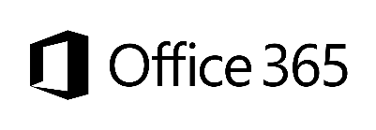










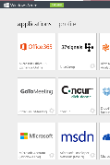
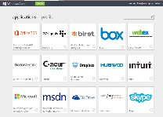

Key Scenarios to get started with Microsoft Azure
Identity as a Service
SaaS
Active Directory
Active Directory
Synchronize and
consolidate
identities
Custom LOB apps
ISV/CSV apps
Azure App Service and Non-MS cloud-based apps
PCs and devices
Notes:
Speaker notes:
Identity as a Service; Control and protect your apps, data and services in Azure together with assets in non-MS cloud using a single AD account.
Consolidate all your identities using one account for single sign-on to any cloud and on-premises services, using your favorite device, including iOS, Mac OS X, Android, and Windows devices.
As a developer you must also need to understand implications of extending your credentials in on-premises Active Directory to Azure Active Directory to protect your assets in on-premises and in the cloud.

Slide 40



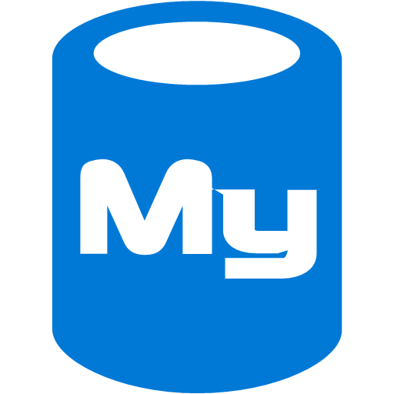



On-premises /
Hosting Services
IIS/SQL Server Based
Web Apps
Microsoft
SQL
Server
IIS
Non-IIS Open Source
Web Apps
Microsoft Azure
MySql
Web Apps - Take your web apps to the cloud using inexpensive App Service Web Apps
Key Scenarios to get started with Microsoft Azure
Notes:
Speaker notes:
You can easily move your existing IIS based web apps including SQL Server databases to Azure App Service easily with a migration tool provided by Microsoft called Azure App Service Migration Assistant.
If your open source web app’s framework is supported on App Service, the languages and frameworks needed by your application are configured for you automatically. Migrate an existing application or create a new one from the Application Gallery.
Consider using Azure Cloud Services or IaaS Virtual Machines if you are unable to migrate your application via Migration Assistant or your open source web app’s framework isn’t supported on App Service.
Other notes:
Windows Server 2003 will reach end of support on July 14th 2015. If you are currently hosting your websites on an IIS server that is Windows Server 2003, Web Apps is a low-risk, low-cost, and low-friction way to keep your websites online, and Web Apps Migration Assistant can help automate the migration process for you.
Moving to Web Apps require less time and IT expertise to configure and secure your apps compared to apps running in VM environment.
Web Apps require no maintenance effort on your part to patch, update, and manage underlying VM environment.

Slide 41
Azure
SQL DB
App Service
Key Scenarios to get started with Microsoft Azure

Slide 42
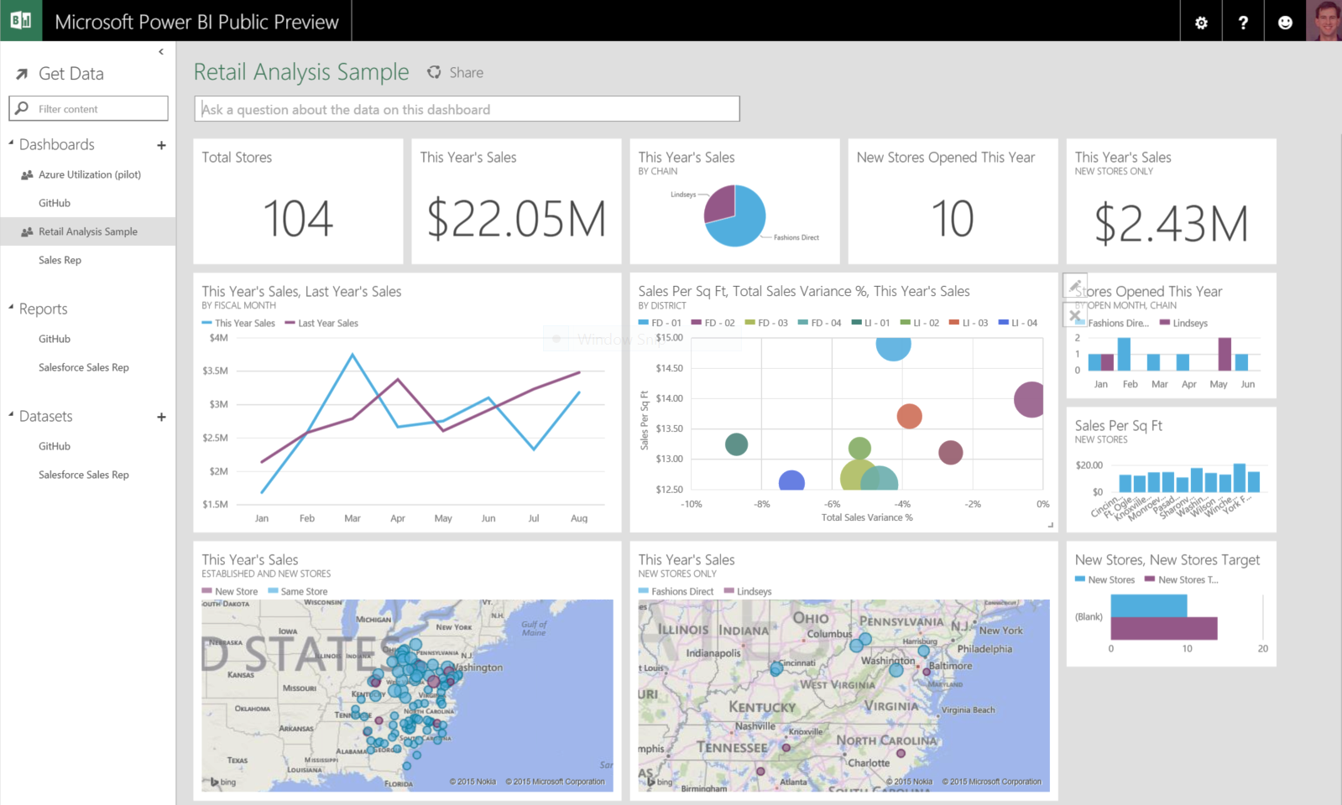
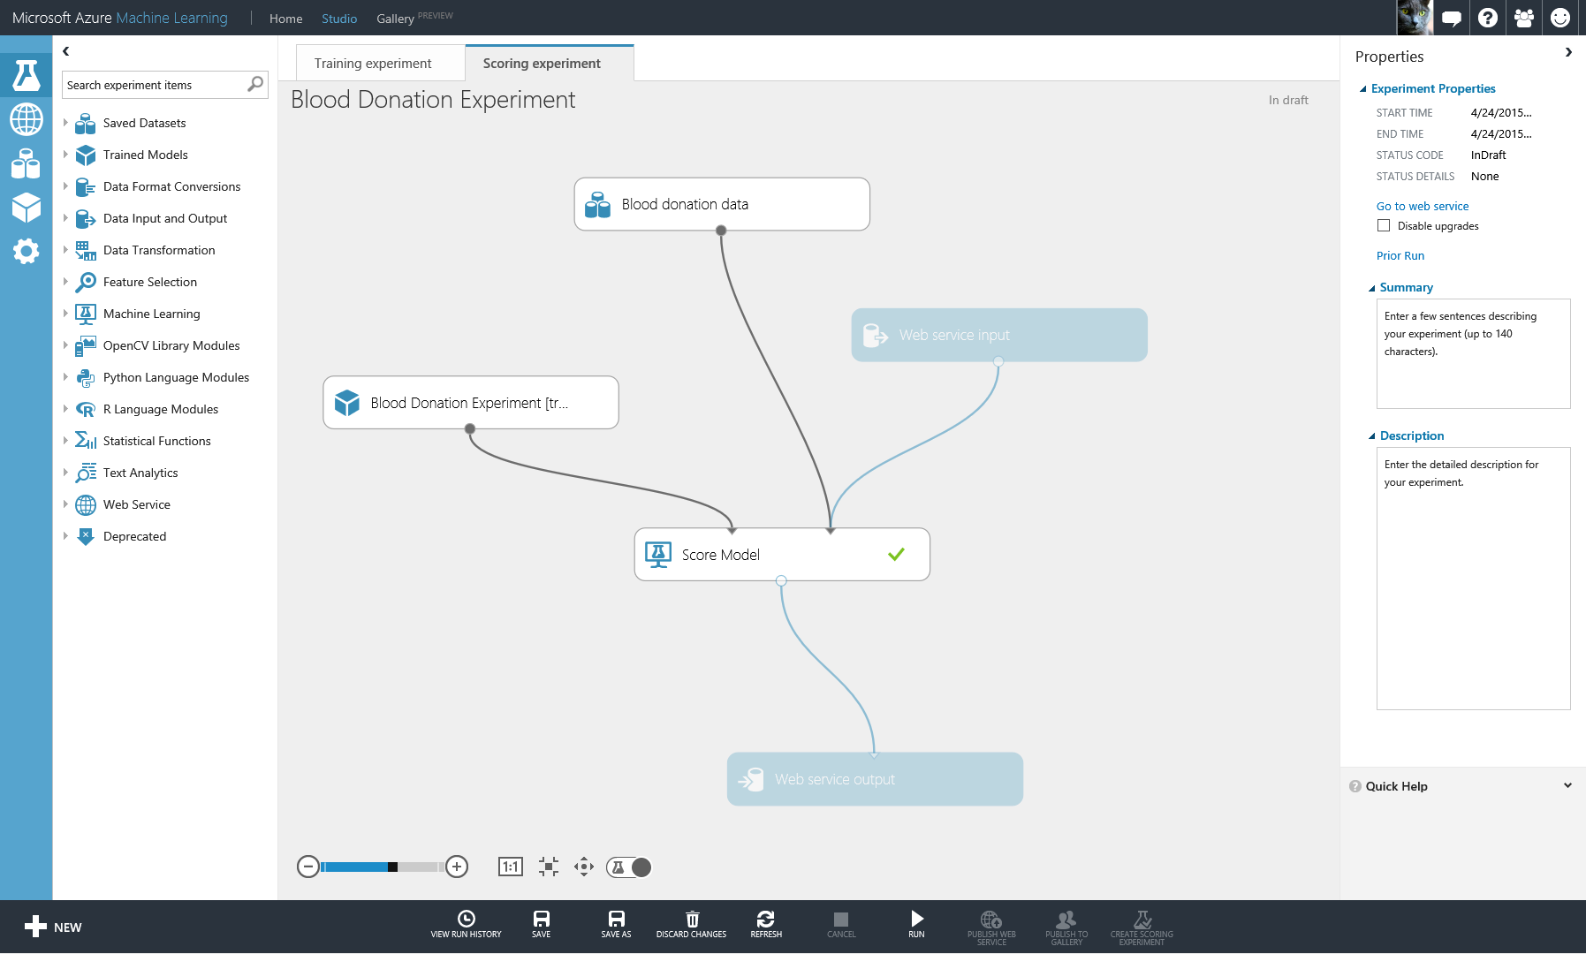

Machine Learning
Reporting
Data Visualization
Hadoop
SQL Data Warehouse
SQL DB
App Service
On-Premises
SAP
Oracle
Dynamics

Slide 43
Hadoop
SQL Data Warehouse
SQL DB
App Service
Intelligent Action
Machine Learning

Slide 44
Activate your MSDN Benefits…
+
3 VMs for 16 hrs a day
80 VMs for 20 hour load test
Up to 100 web sites + DB
Up to
$150
33%^{off}
25%^{off}
89
per Month
Dev/Test VMs
Other Dev/Test
Countries

Slide 45
Get started today at http://azure.microsoft.com

Slide 46


Get started
Visit azure.microsoft.com

Slide 47
Questions?

Slide 48
Let’s Do a Lab!
Start at https://github.com/Azure-Readiness/DevCamp/tree/master/HOL
Lab 1 – Setup
Visual Studio
Azure SDK for .NET (Visual Studio)
Azure PowerShell
Azure CLI
Notes:
https://github.com/Azure-Readiness/DevCamp/tree/master/HOL

Slide 49
The Cloud is changing the world

Slide 50
Customer Stories

Slide 51
Digital Library Provider
Moving from on-premises to “Azure first”
Embrace platform services – don’t want to manage servers
U.S. audience with growing global presence
Very sensitive to performance metrics
Primarily in East US; moving more to West US too
Notes:
Overdrive

Slide 52




FE Web App
API App
Search
Metadata
Nginx cluster
Nginx cluster
Windows Server 2012
Ubuntu / node.js
Elasticsearch
East US
Web API
ASP.NET Web API
Azure SQL DB (S0)
FE Web App
Node.js web application
Azure Redis Cache
Standard
C4
Elasticsearch Cluster
9 Ubuntu VMs
2 Ubuntu servers (Nginx as front end servers)
Metadata Cluster
2 Windows Server 2012 VMs (7 in future)
A3
On-Premises

Slide 53
Health and Wellness Provider
Startup with “v1” in Azure
VMs
Web Apps
Azure Storage
Microsoft and non-Microsoft technologies
Monolithic architecture hard to change
“v2” architecture based on Azure Service Fabric
Growing interest in “big data” – analytics, Machine Learning, etc.
Notes:
Higi

Slide 54
Azure SQL Database
Azure DocumentDB
Retrieve
Hot
Azure Stream Analytics
Client
Ingest
Batch Processing
Data Warehouse
Analytics Clients
Web App
HDInsight / Apache Storm
Batch Storage
Tableau
Azure EventHub
Azure SQL Data Warehouse
Cold
Azure Blob Storage
HDInsight
Hive/Pig
EventProcessorHost (e.g. Worker Role, SF Service, etc.)
Or
PowerBI
Or/and
Or/and
HDInsight HBase
Azure Data Lake Storage
Azure ML
Azure Data Lake Analytics
(U-SQL)
Azure Search
Web API / Web App
Further information need to determine which technology option is the right fight for given scenario (business/technical needs).
Options for future growth / opportunity without needed to swap out ingestion technologies / services.
Web application logs user events to an Azure EventHub.
Azure Stream Analytics or HDInsight Storm would retrieve event data from EventHub.
Stream Analytics jobs would dispatch the data to both a “hot” and “cold” processing path:
Hot – Dump data to a data store for near real-time processing (dashboard, search, etc.). Low latency, very little processing
Cold – batch style processing against a larger data set; more processing / analysis.

Slide 55
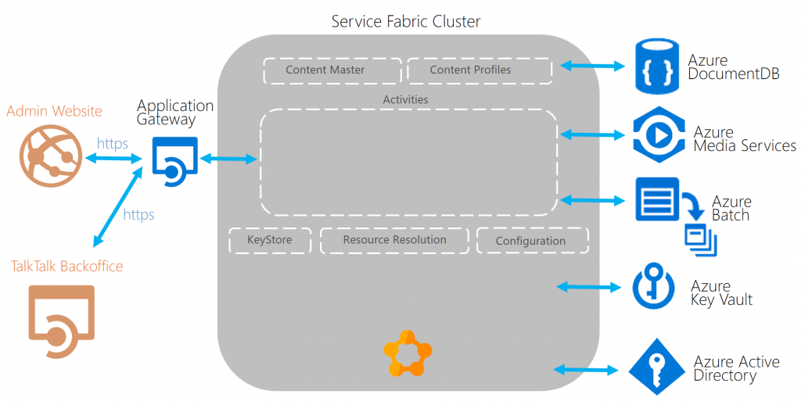
TalkTalk TV
Existing Azure IaaS solution - ~100 VMs
1.5 PB of data
Blob storage, Media Services, SQL Server
Need to move to faster dev cycles – break the monolith
Move to Service Fabric
The one-box development experience with the full Service Fabric services available locally increased our productivity and enabled us to deliver more features faster”.
Mike Goatly, Talk Talk TV Development Lead
https://blogs.msdn.microsoft.com/azureservicefabric/2016/03/15/service-fabric-customer-profile-talktalk-tv/
Notes:
Digital assets in Blob storage
Integrate with existing solution
Applications are independently deployable and isolated: A key advantage of the Service Fabric application and service model is the ability to update individual application instances and their services and move to a continuous deployment approach.

Slide 56
TalkTalk TV
Notes:
A Service Fabric cluster hosts all the Service Fabric applications that make up the content encoding and resource resolution application. The Service Fabric applications consist of both stateless and stateful services.
Media Services is used to encode and stream over 1.5 PB of content, encoded into a variety of formats that is served on demand to different devices.
Document DB is used to store a JSON representation of the application’s actor state. This enables disaster recovery, and is also used for ad-hoc querying.
Application Gateway is used to provide SSL termination management
Key Vault is used to securely store application secrets, certificates and configuration keys.
Azure Active Directory is used to provide user and cross-service authentication and control access to the Service Fabric applications and their microservices.
Azure Batch is used to extend the Media Services capabilities and perform the Marlin encryption, a digital rights management (DRM) format. Batch provides a pool of VMs and the ability to orchestrate, submit, and monitor jobs. The workflow running in Service Fabric decides the type and number of VMs to use, then submits the job using the Azure Batch SDK, where the data is input and output via Azure blob storage.

Slide 57
Jet.com
Notes:
Jet.com

